Slide 1
Ubuntu
A linux operating system
https://ubuntu.com/

Slide 2

What is Ubuntu?
Ubuntu is a complete Linux operating system.
The primary use of Ubuntu was to make linux easier to use for non-programmers.

Slide 3
What is Linux?
Linux is a kernel, which is the core component of any operating system and allows software to communicate with hardware. A kernel, on its own, is not an operating system, but rather a set of computer instructions that enable communication between software applications and the data processing done at the hardware level.

Slide 4
How does Ubuntu work?
Ubuntu relies on the architecture of Linux to communicate with a computer's hardware so that software can do what it's supposed to do. Ubuntu commands follow the rules and procedures that hundreds of other Linux distros also use.
Ubuntu has a graphical user interface (GUI), making it similar to other popular operating systems like Windows, Mac OS and even smartphone systems like Android.

Slide 5
GNOME (Linux Interface)
GNOME is a desktop environment for free and open source operating systems. It comes from the GNU Project, which has been providing the world with free software for over three decades.
Just like Ubuntu uses the Linux kernel to make software communicate with your computer, it uses GNOME to provide the user with an easy-to-use onscreen interface. The panel showing the time, the launcher that opens apps, and the overview screen showing all your open windows are all part of GNOME.

Slide 6
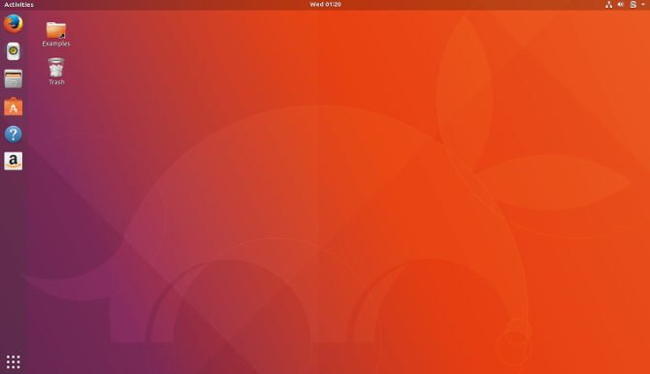
The Ubuntu Interface

Slide 7
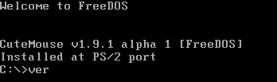
What is CLI?
CLI is a command line program that accepts text input to execute operating system functions.
In the 1960s, CLI was the only way for the user to interact with the computer.
CLI is still used by software developers and system administrators to configure computers, install software, and access features that are not available in the graphical interface.
An example of CLI:

Slide 8
Important CLI commands for Ubuntu.
Sudo command allows you to run programs or other commands with administrative privileges, just like “Run as administrator” in Windows.
Apt-Get is used to install, update, upgrade and remove any package. apt-get basically works on a database of available packages.
Ls command lists all files and folders in your current working directory.
Cd Linux command also known as chdir used to change the current working directory.
Pwd Ubuntu command displays the full pathname of the current working directory.

Slide 9
Difference between Windows and Ubuntu
Ubuntu
Windows
Ubuntu is an open source free OS.
Ubuntu requires the user to learn a lot of commands.
Ubuntu is much secure compared to windows.
Ubuntu has a centralized application installation system.
Ubuntu is not used for gaming.
Windows is a paid and licensed OS.
Windows is user-friendly and does not require to learn any commands.
Data breaching on windows is easier compared to Ubuntu.
Windows does not have a centralized application installation system.
Windows is more optimized for gaming.

Slide 10
Conclusion
In conclusion, Ubuntu is user friendly linux OS made for beginners. It is a free operating system so it will not cost any money for installation. Ubuntu does not require any kind of antivirus because the OS is secure itself. The system requirements of Ubuntu is low, meaning, a core 2 duo can handle the OS superlatively. There is no harm in using Ubuntu as a beginner and for programmers and developers, Ubuntu is the best choice.

